Slide 1
LAB 01: GitHub
PPOL 5206: Spring 2025

Slide 2
Introduction to GitHub
A platform for version control and collaboration, allowing users to manage code and track changes using Git
A repository hosting service where you can store and share code, documentation, and other files with a global audience
Works with GitHub Desktop
Owned by Microsoft

Slide 3
How GitHub can be Useful for the Class
Project Collaboration:
Share and collaborate on code, making teamwork easier and more organized
Version Tracking:
Track changes in your code over time, making it easy to undo mistakes and understand development history
Portfolio Building:
Showcase your projects on GitHub Pages, creating a professional portfolio for potential employers
Skill Development:
Provides hands-on experience with an industry-standard tool used by data scientists and engineers

Slide 4
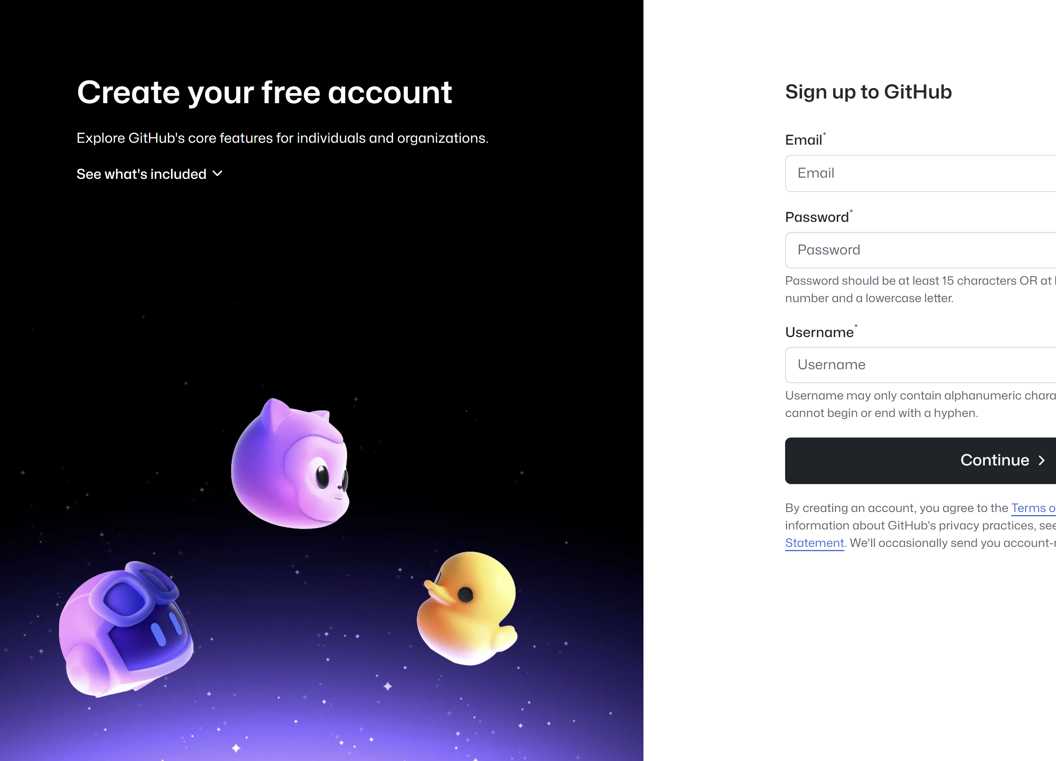
Signing Up
Go to https://github.com
Click Sign Up and complete the registration form.
Enter email, create a username and password.
Choose whether to opt into GitHub marketing emails.
Verify your email address (check inbox for confirmation email).
Select a free or pro plan (students can apply for free Pro access via the GitHub Student Developer Pack).

Slide 5
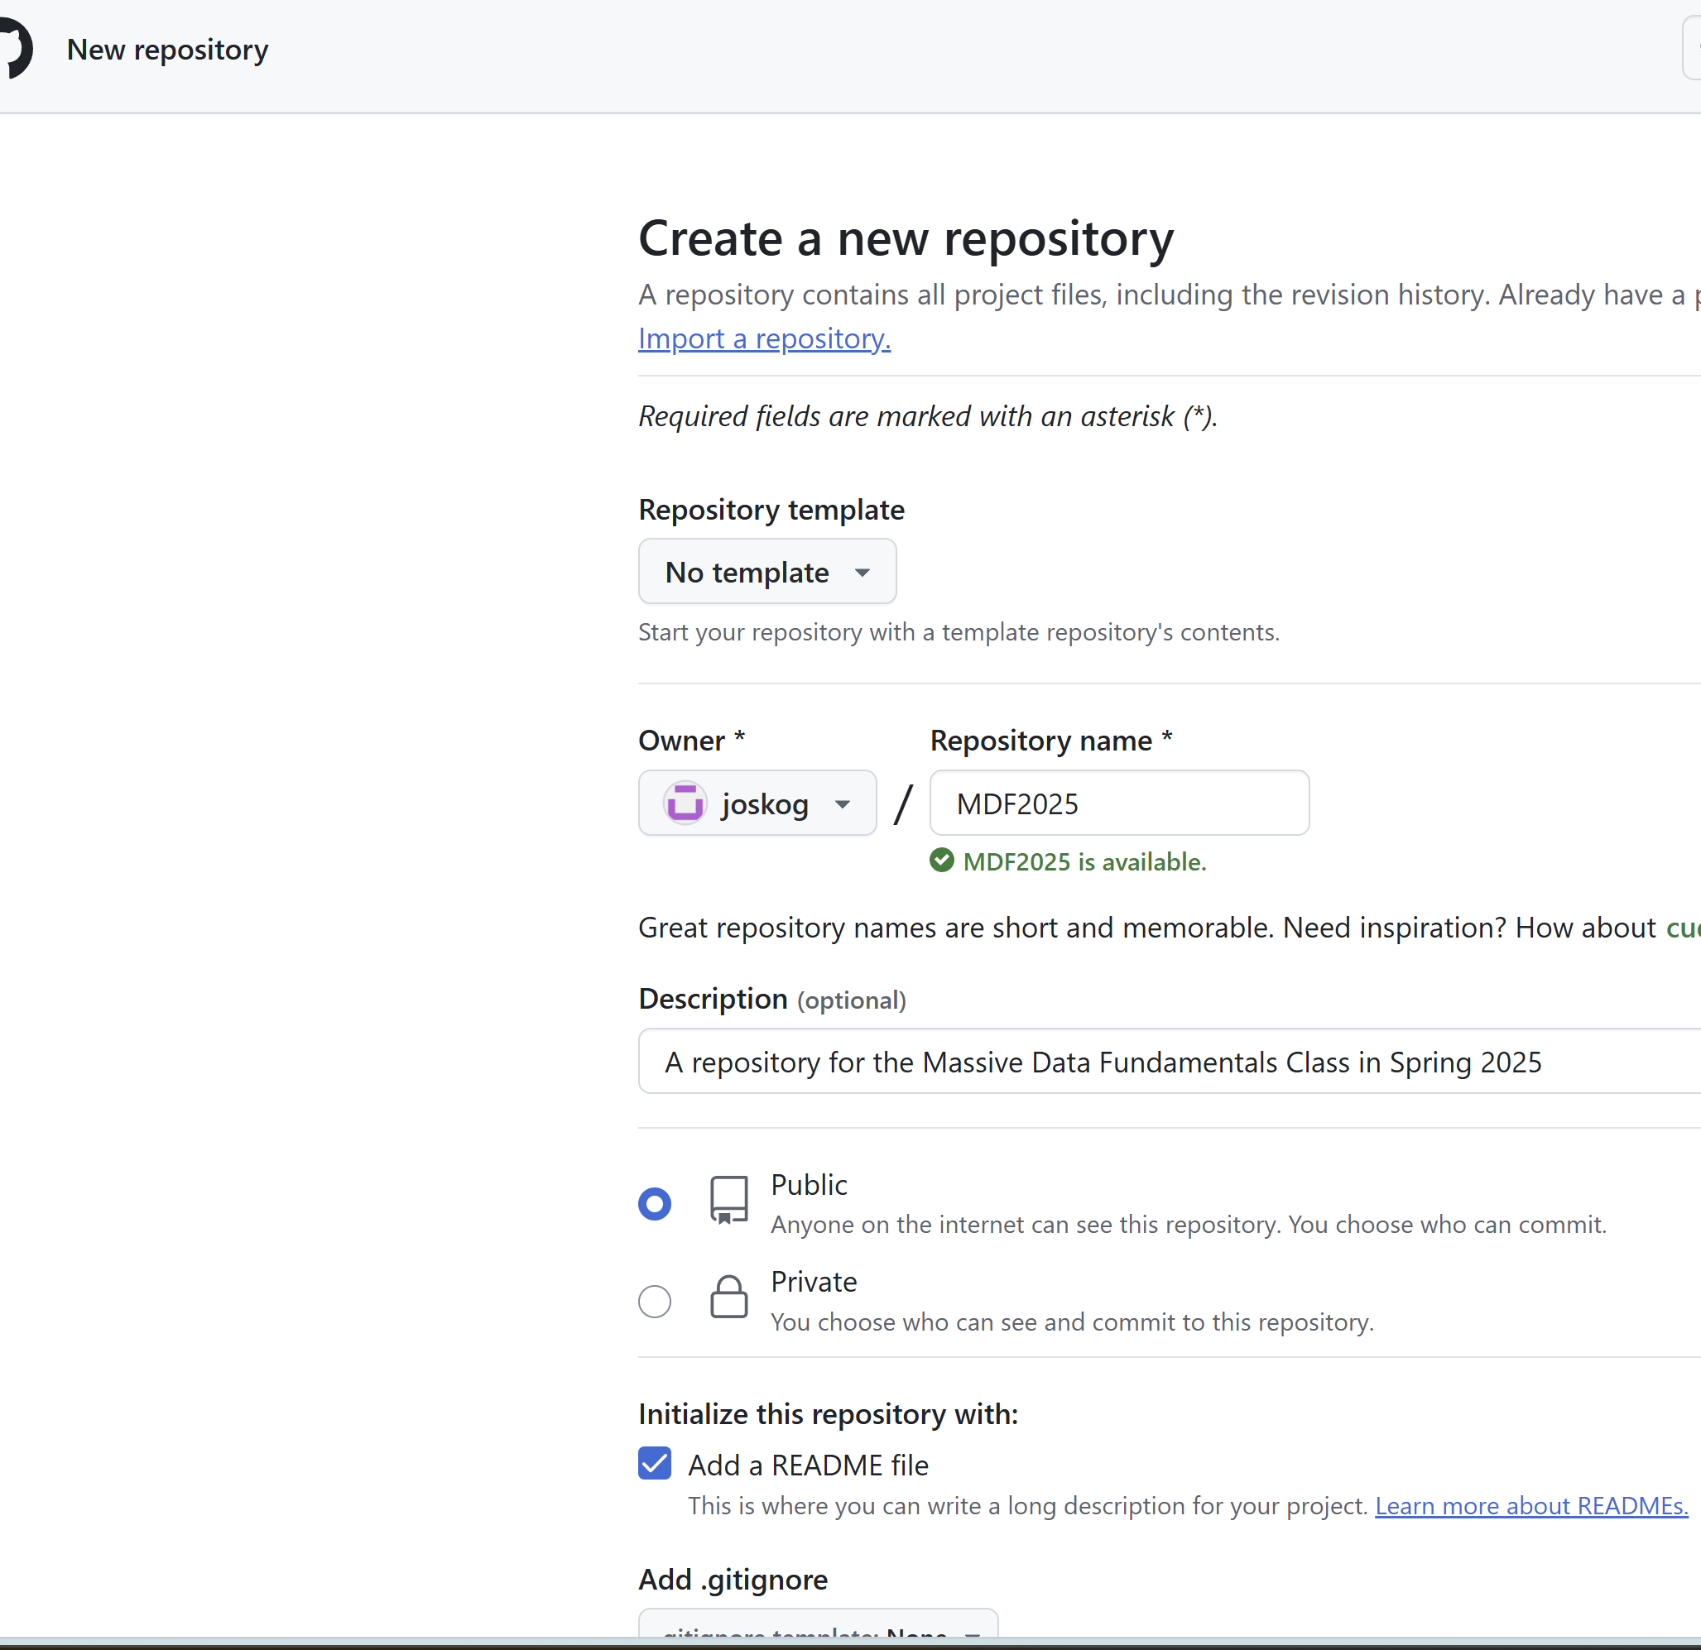
Creating a Repository
Log in to GitHub and click the New Repository button.
Fill out:
Repository name: username.github.io (replace username with your GitHub username).
Set the repository to public.
Initialize with a README.md file.
Click Create Repository.

Slide 6
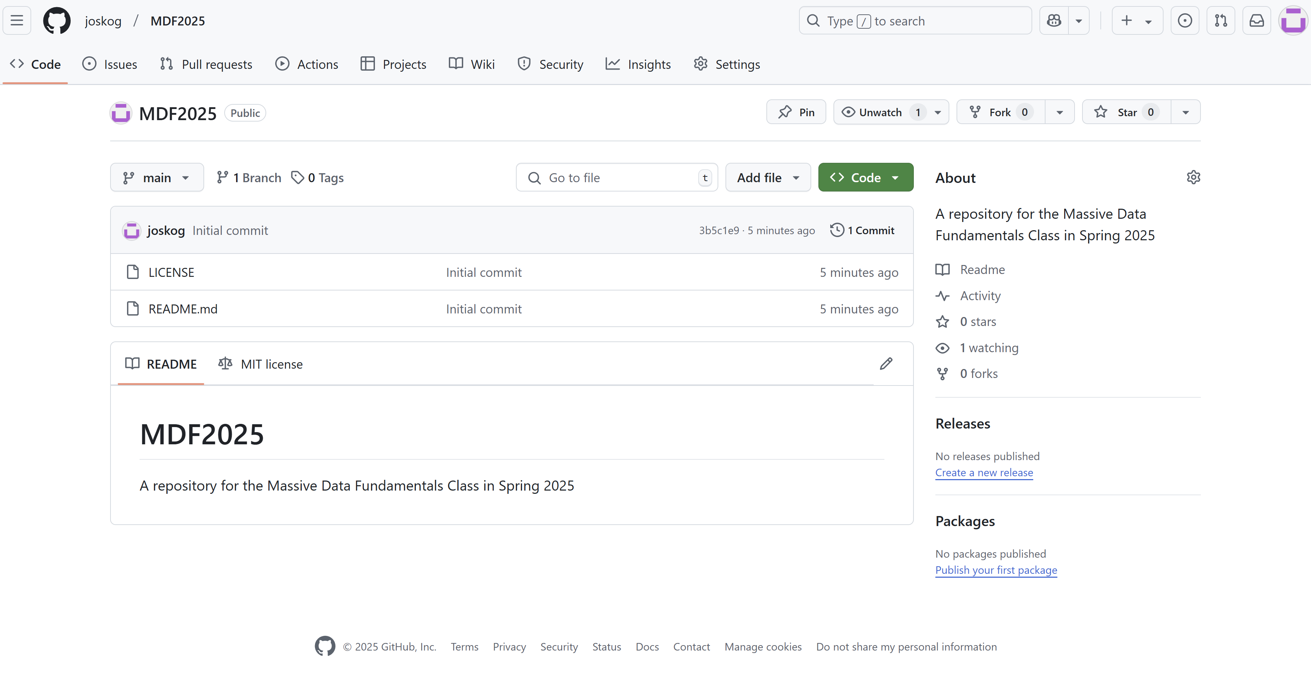

Slide 7
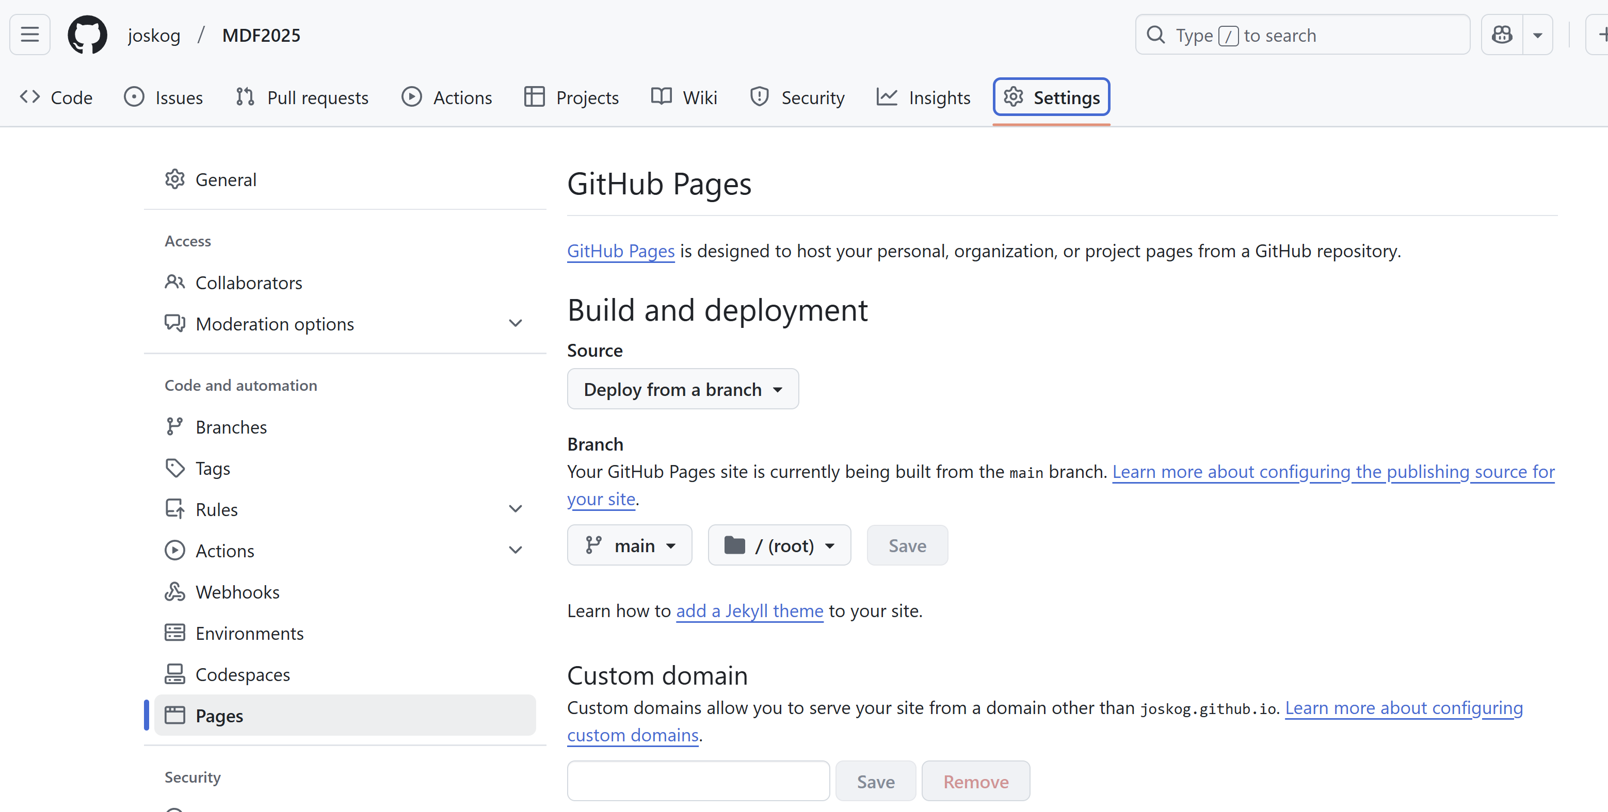
Creating a GitHub Page
Go to the repository's Settings > Pages.
Under "Source," select main (or master) branch and the /root folder.
Click Save.
Your website will be live at https://username.github.io/.

Slide 8
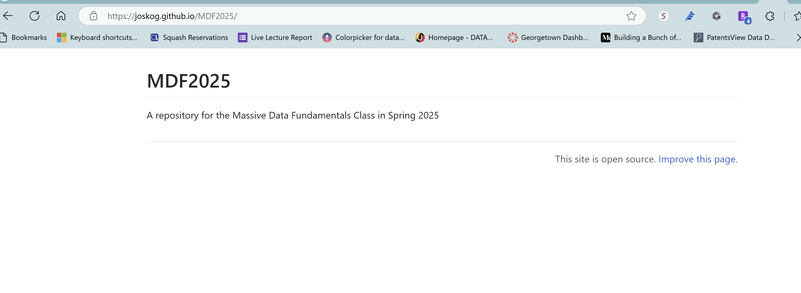

Slide 9
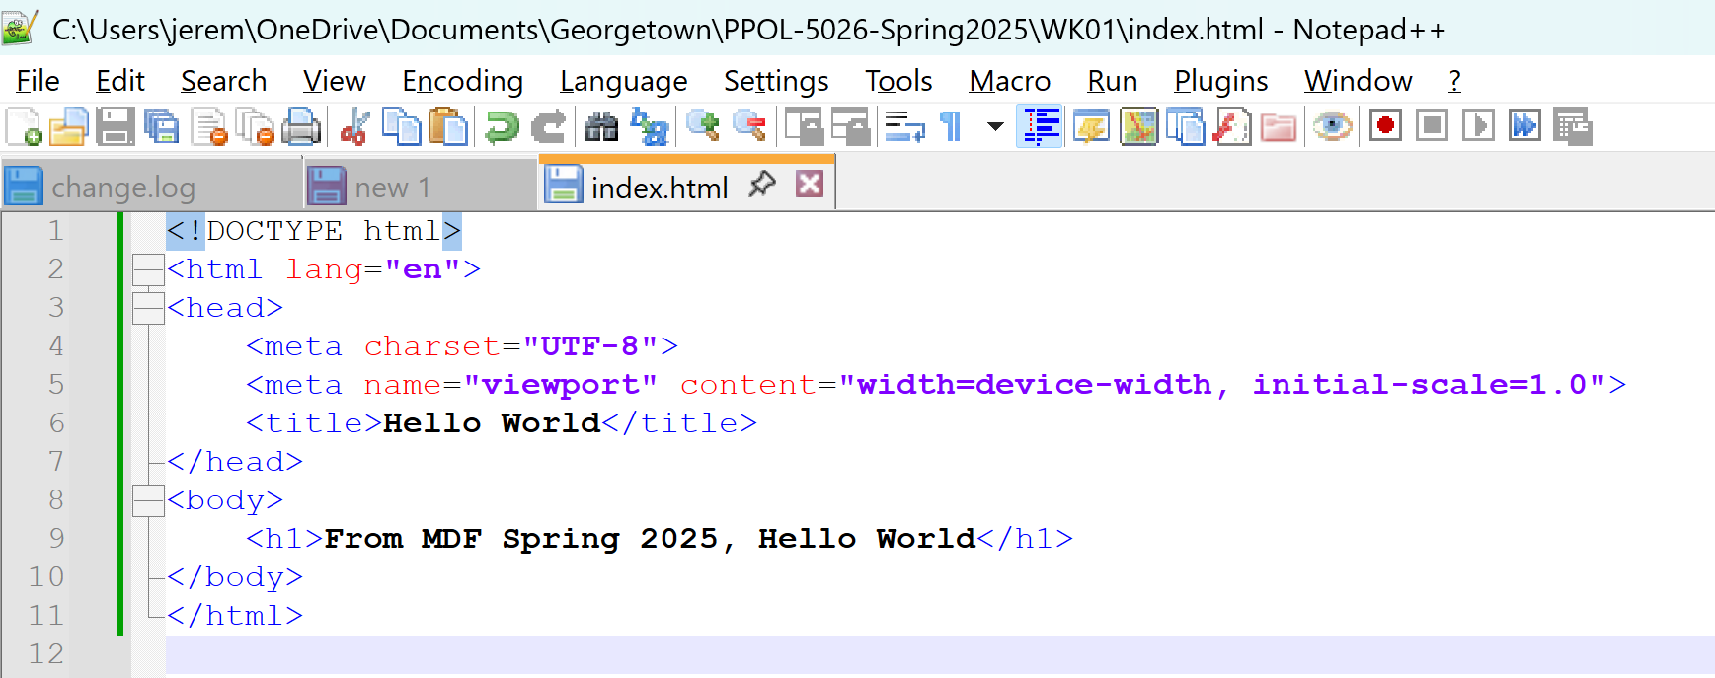
Add an index file
Use your preferred text editor to make a file named “index.html”

Slide 10
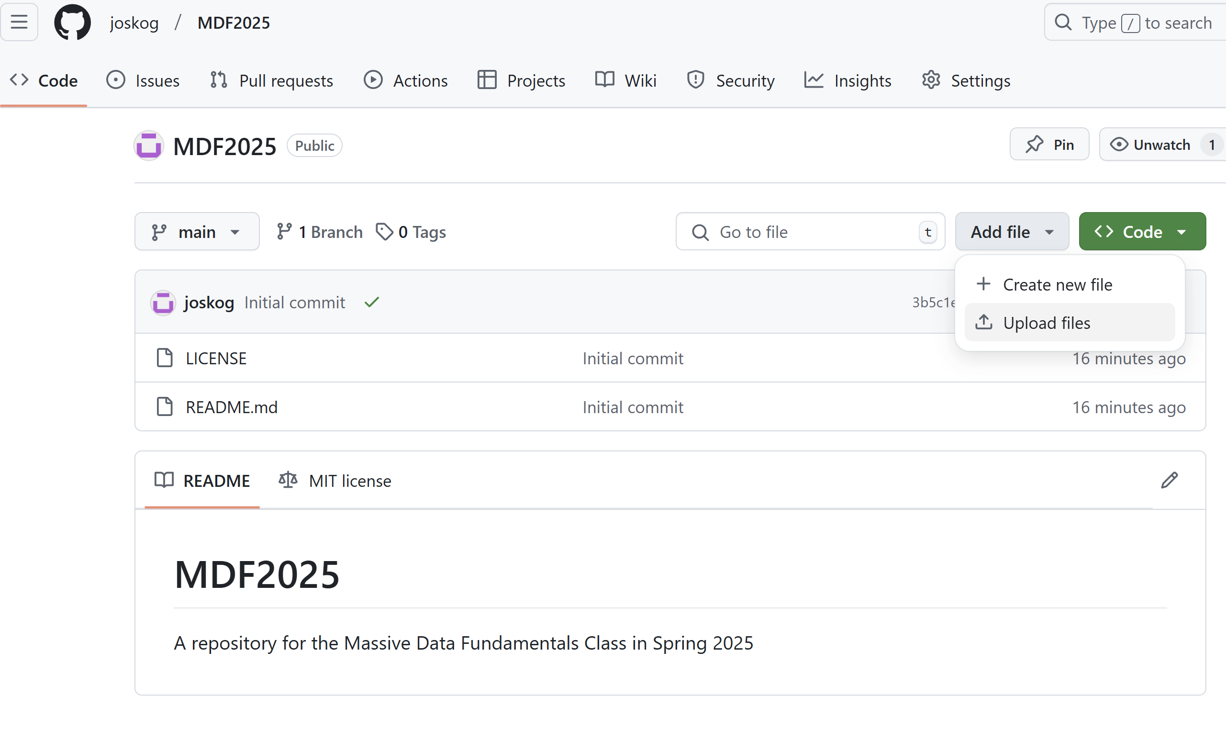
Upload the index file
Select “Add File” from within your repository

Slide 11
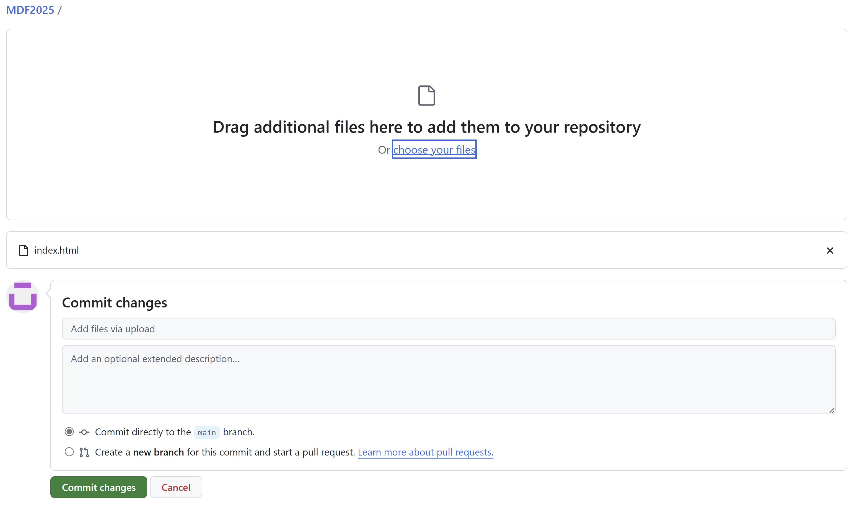
Commit the Changes
Commit the Changes using the button

Slide 12
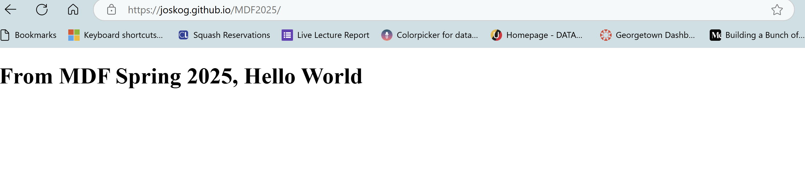

Slide 13
About the “readme.md” file
The index.html file takes precedence over the README.md file for rendering the homepage of your GitHub Pages site.
The README.md file will still appear as the default content when viewing the repository directly on GitHub (e.g., https://github.com/username/MDF2025).
Reasons to Keep the README File
Repository Documentation:
The README.md provides useful context for anyone browsing the repository on GitHub, such as an overview of the project, setup instructions, or contributor guidelines.
No Conflict:
GitHub Pages will prioritize the index.html for the site at https://username.github.io/MDF2025/.
The README.md will remain visible on the repository page (https://github.com/username/MDF2025).
Best Practice:
Keeping the README.md alongside the index.html file is considered good practice to ensure clarity for different audiences.

Slide 14

GitHub Copilot

Slide 15
On your own:
Consider an optional GitHub student account
01
Consider an optional GitHub Copilot
02
Email a screenshot of your Repository website to js5497@georgetown.edu
03

